Slide 1
Bipolar Junction Transistors
Topic 3 (Chapter 3)

Slide 2
Bipolar Junction Transistor (BJT)
A semiconductor device that can amplify (enlarge) electronic signals such as radio and television signals
The transistor has led to many other semiconductor inventions including the integrated circuit (IC)
  Backbone of modern civilization
Bipolar means “two polarities” - electrons and holes

Slide 3
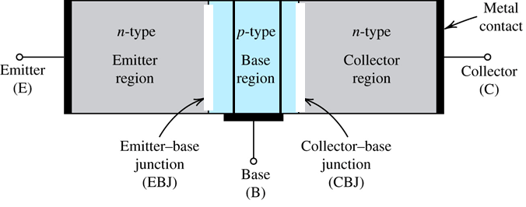
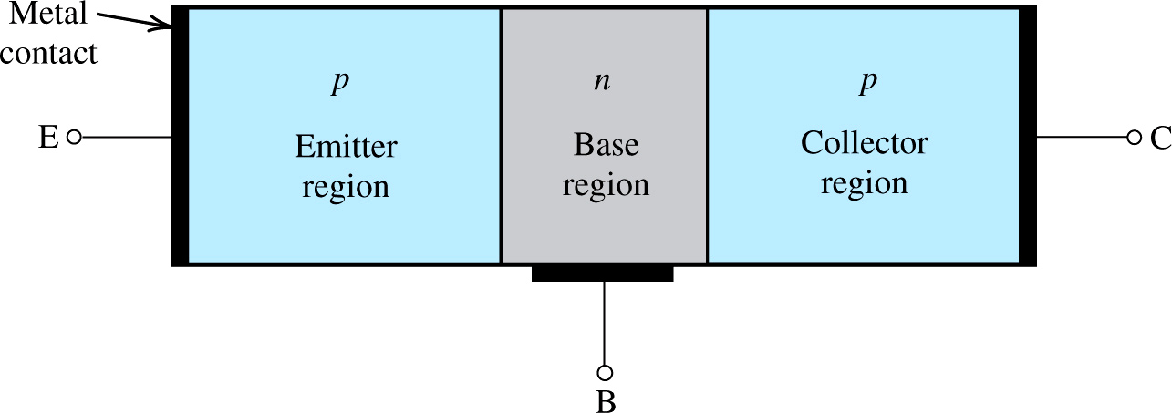
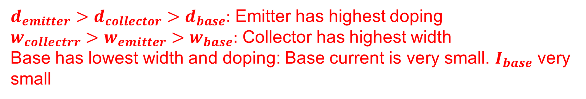
BJT Device Structure
NPN
PNP
$d_{emitter}>d_{collector}>d_{base}:$ Emitter has highest doping
$w_{collectrr}>w_{emitter}>w_{base}:$ Collector has highest width
Base has lowest width and doping: Base current is very small. $I_{base}$ very small

Slide 4
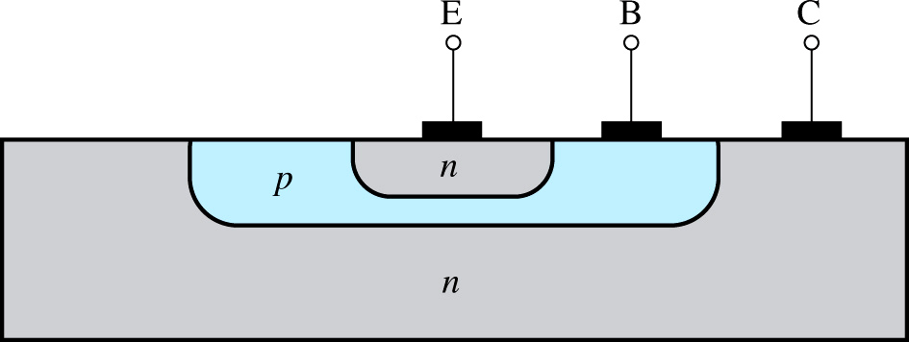
The Structure of BJT Transistors in ICs
Figure: A more realistic (but still simplified) cross section of an npn BJT
The collector virtually surrounds the emitter region
The device is not symmetrical, and thus the emitter and collector cannot be interchanged.

Slide 5
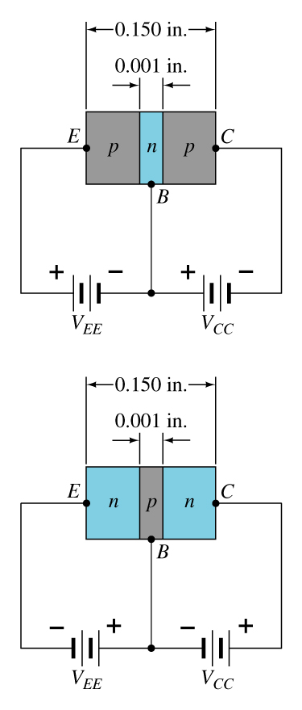
Discrete Component BJT Construction
BJT: Three terminals. Emitter, Base, Collector.
BJT: Two Junctions.
Emitter – Base Junction (EB)
Collector – Base Junction (CB)
pnp
EB | CB
FB | FB | ON: Saturation mode
FB | RB | Amplifier: Active mode
RB | RB | OFF: Cutoff mode
RB | FB | Inverter
npn

Slide 6
Unbiased transistor
Three doped regions: emitter, base, and collector
Two pn junctions: emitter-base and base-collector
  Like two back-to-back connected diodes
Two types: NPN or PNP
Silicon or germanium

Slide 7
The bipolar junction transistor has 3 doped regions.
N
COLLECTOR (medium doping)
P
BASE (light doping)
N
EMITTER (heavy doping)

Slide 8
Biased transistor
BJT in Active mode
Forward bias the emitter diode
Reverse bias the collector diode
BJT works as an Amplifier

Slide 9
In a properly biased NPN transistor, the emitter electrons
diffuse into the base and then go on to the collector.
R_{C}
N
V_{CE}
R_{B}
P
V_{CC}
V_{BE}
N
V_{BB}

Slide 10
Purposes of Different Transistor Regions
The heavily doped emitter emits or injects its free electrons into the base
The lightly doped base also has a well-defined purpose: to pass emitter-injected electrons on to the collector
The collector is so named because it collects or gathers most of the electrons from the base

Slide 11
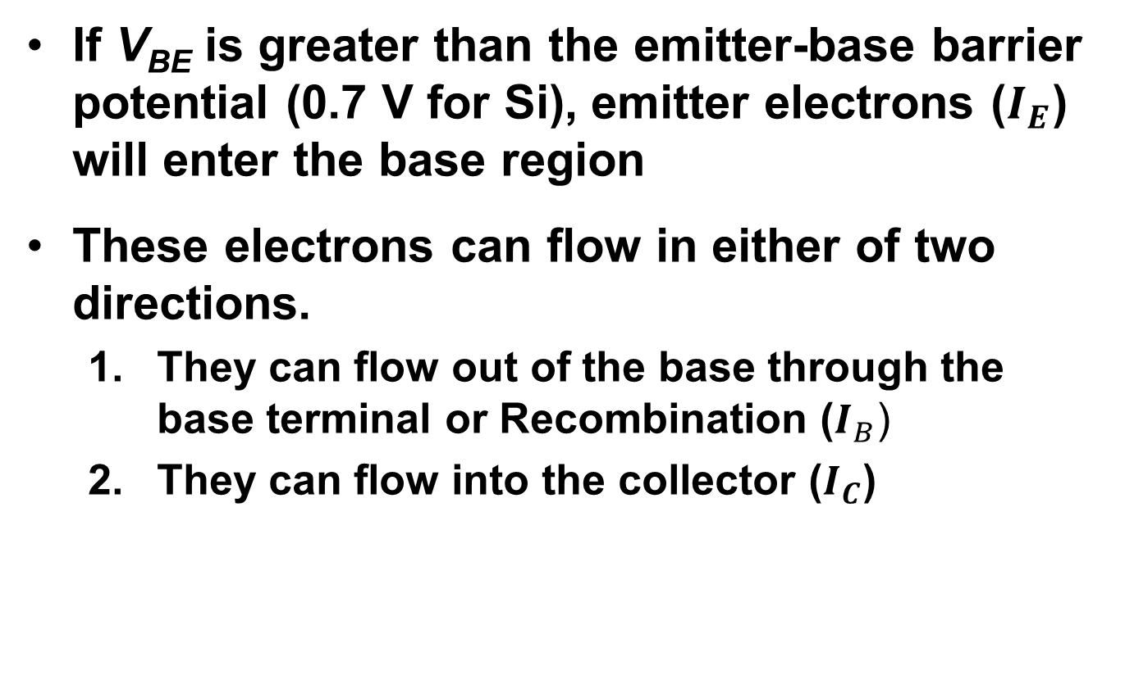
Electron Movement
If V_{BE} is greater than the emitter-base barrier potential (0.7 V for Si), emitter electrons ($I_{E}$) will enter the base region
These electrons can flow in either of two directions.
  They can flow out of the base through the base terminal or Recombination ($I_{B}$)
  They can flow into the collector ($I_{C}$)

Slide 12
Which way the free electrons in the base region go?
Most continue on to the col­lector
  Why?
    The base is lightly doped and very thin
    The light doping means that there are very few majority carriers
    The very thin base means that the free electrons have only a short distance to go to reach the collector
    The positive voltage (reverse voltage) applied to the collector pulls them towards the collector
    For these reasons, almost all the emitter-injected electrons pass through the base to the collector.
  Only a few free electrons will recombine with holes in the lightly doped base

Slide 13
Summary of Carrier Flow in a Biased
NPN Transistor
V_{BB} forward biases the emitter diode
  Forces the free electrons in the emitter to enter the base
The thin and lightly doped base gives almost all these electrons enough time to diffuse into the collector
These electrons flow through the collector, through R_{C} and into the positive terminal of the V_{CC} voltage source
R_{C}
N
R_{B}
V_{CE}
P
V_{CC}
V_{BE}
N
V_{BB}

Slide 14
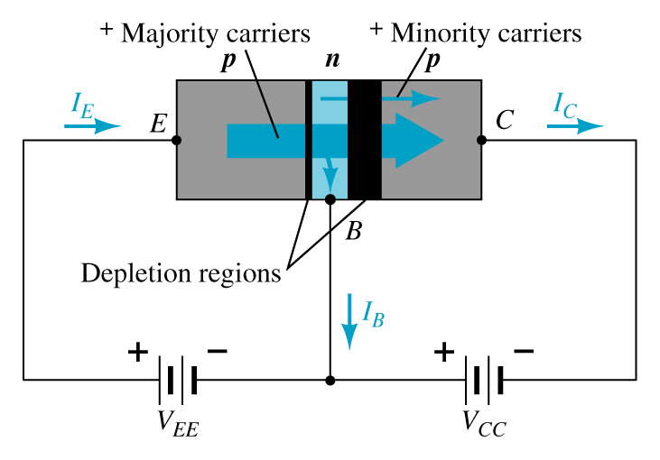
Transistor Operation
With the external sources, V_{EE} and V_{CC}, connected as shown:
  The emitter-base junction is forward biased
  The base-collector junction is reverse biased

Slide 15
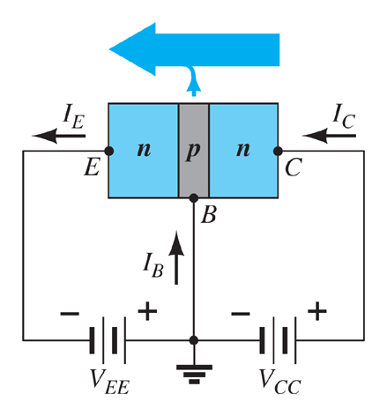

Currents in a Transistor
Emitter current is the sum of the collector and base currents:

Slide 16

Carrier flow in a pnp transistor
Emitter current is the sum of the collector and base currents:
The collector current is comprised of two currents:

Slide 17
Transistor Connections
There are three useful way to connect a transistor:
CE (common emitter) – most widely used
CC (common collector)
CB (common base)

Slide 18
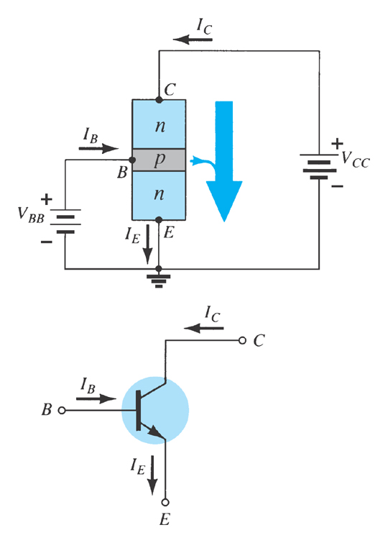
Common-Emitter
Configuration
The emitter is common to both input (base-emitter) and output (collector-emitter) circuits.
The input is applied to the base and the output is taken from the collector.

Slide 19
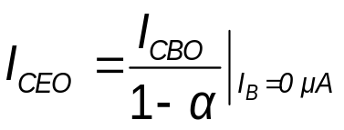
Common-Emitter Amplifier Currents
Ideal Currents
  I_{E} = I_{C} + I_{B} I_{C} = α I_{E}
Actual Currents
I_{C} = α I_{E} + I_{CBO}
    where I_{CBO} = minority collector current
      I_{CBO} is usually so small that it can be ignored, except in high power transistors and in high temperature environments.
When I_{B} = 0 μA the transistor is in cutoff, but there is some minority current flowing called I_{CEO}.

Slide 20
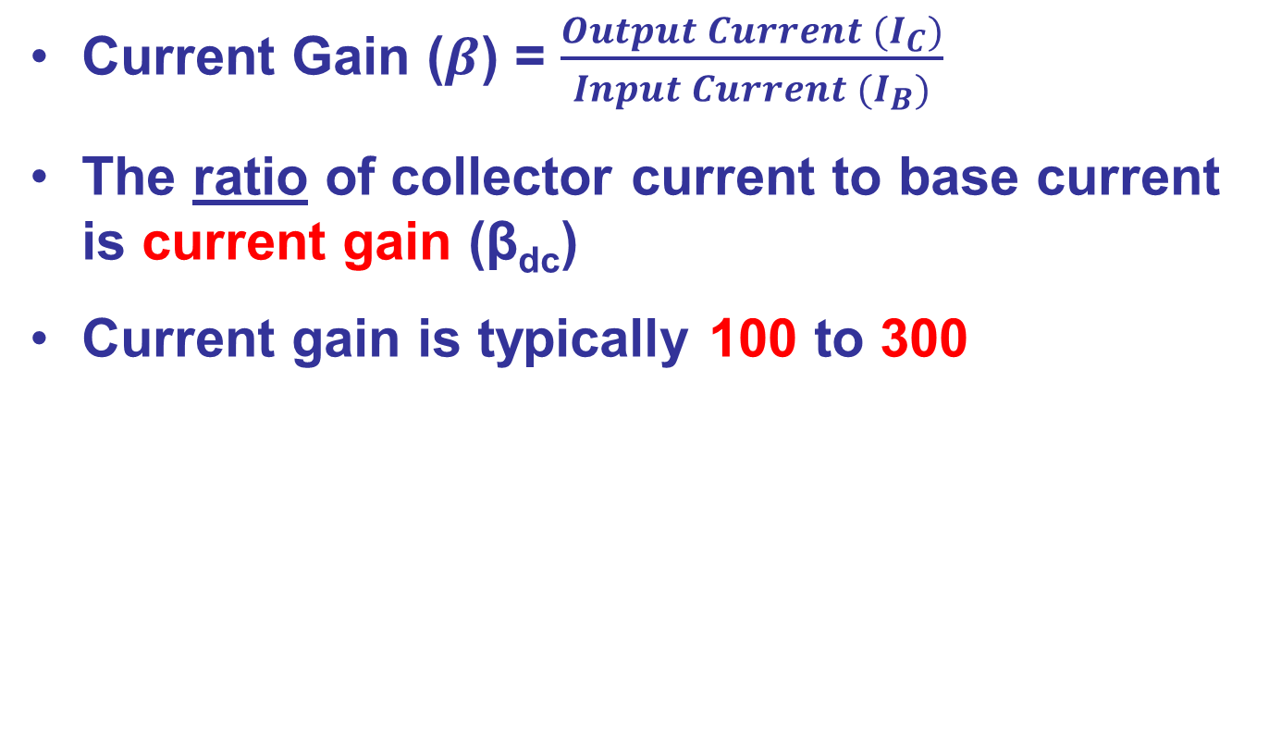
Transistor Current Gain
Current Gain ($β$) = $\frac{Output Current (I_{C})}{Input Current (I_{B})}$
The ratio of collector current to base current is current gain (β_{dc})
Current gain is typically 100 to 300

Slide 21
I_{C}
I_{C}
I_{B}
I_{B}
I_{E}
I_{E}
Electron flow
Conventional flow
I_{E} = I_{C} + I_{B}
I_{C} ≅ I_{E}
I_{B} << I_{C}
I_{C}
I_{C}
α_{dc} =
β_{dc} =
I_{E}
I_{B}

Slide 22
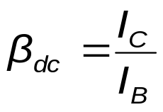
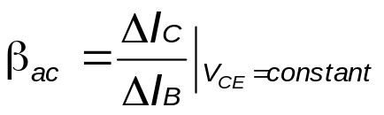
Beta (β)
β represents the amplification factor of a transistor.
In DC mode:
In AC mode:

Slide 23
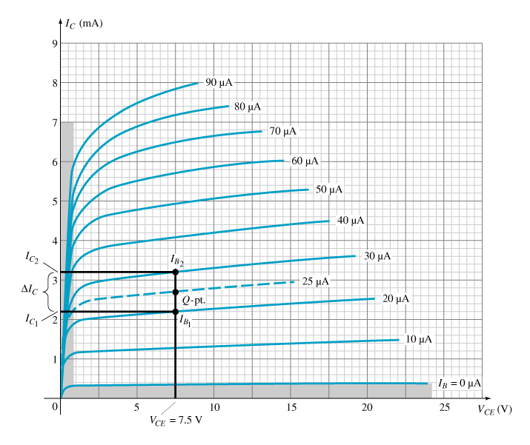
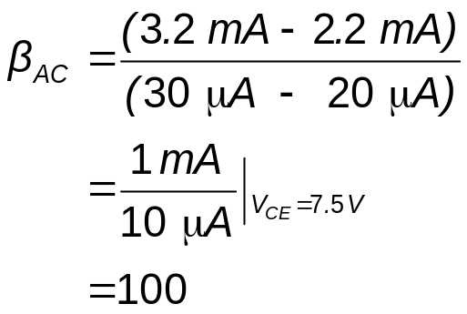
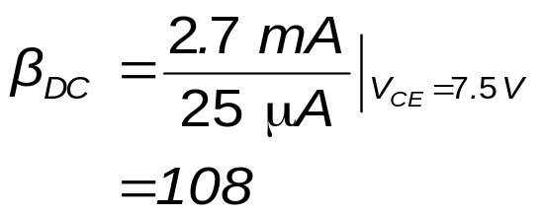
Beta (β)
Determining β from a Graph

Slide 24
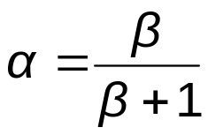


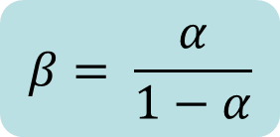
Beta (β)
Relationship between amplification factors β and α :
$$β= \frac{α}{1−α}$$
Relationship Between Currents:

Slide 25

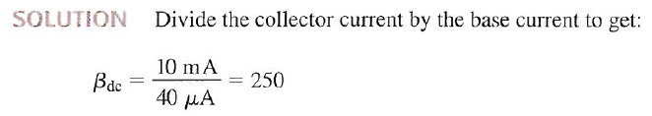

Slide 26


Slide 27

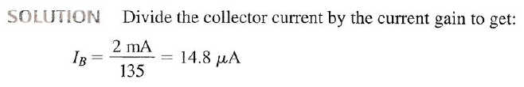

Slide 28
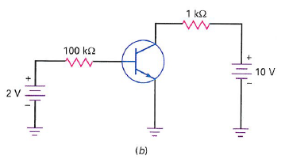



Slide 29
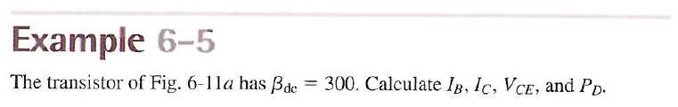
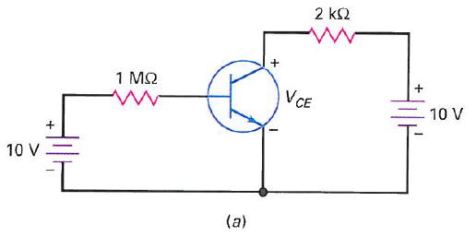
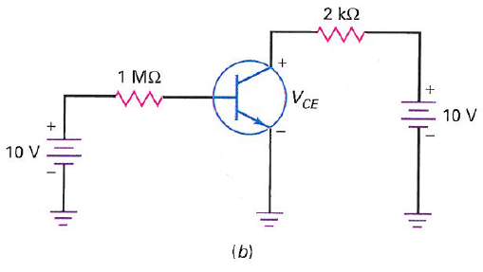
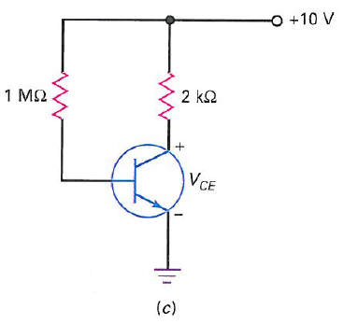



Slide 30
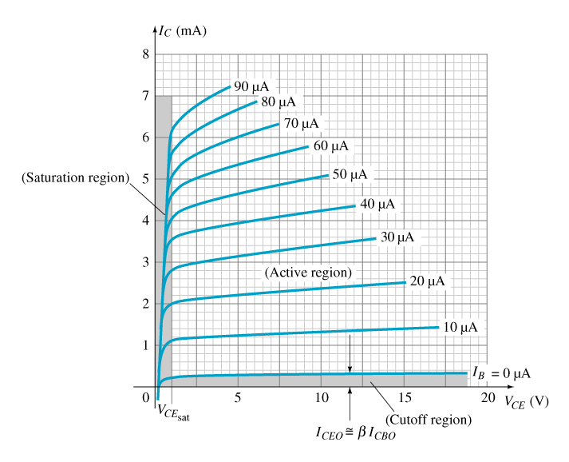
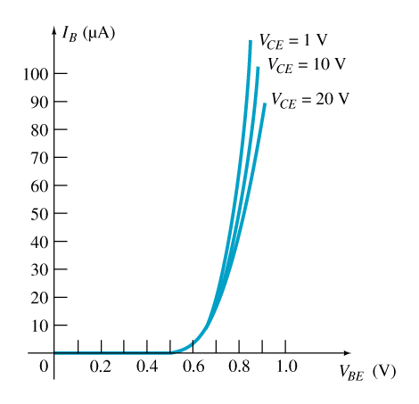
CE Transistor Characteristics
To fully describe the behavior of a BJT, two sets of characteristics are required:
  Driving point or input characteristics
  Output side or output characteristics
Base or Input Characteristics
Collector or Output Characteristics

Slide 31
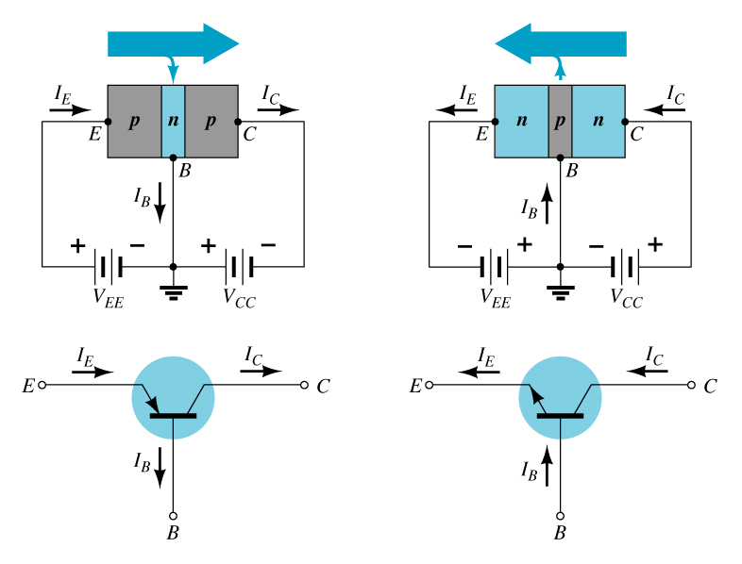
Common-Base Configuration
The base is common to both input (emitter–base) junction and output (collector–base) junction of the transistor.

Slide 32
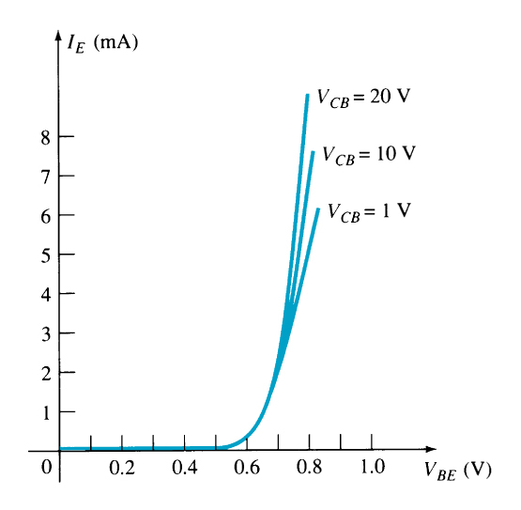
Common-Base Amplifier
Input Characteristics
This curve shows the relationship between of input current (I_{E}) to input voltage (V_{BE}) for three output voltage (V_{CB}) levels.

Slide 33
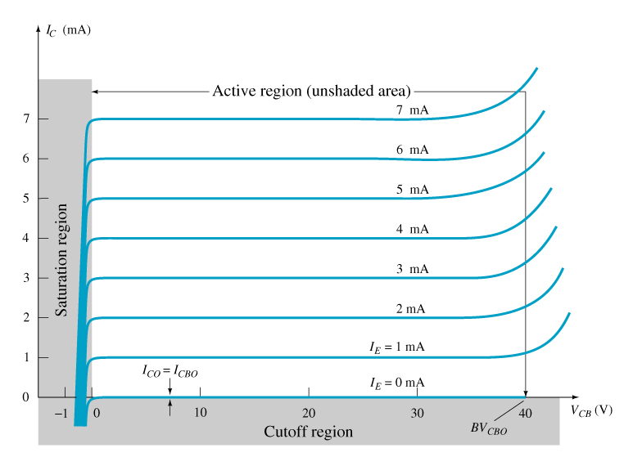
Common-Base Amplifier
Output Characteristics
This graph demonstrates the output current (I_{C}) to an output voltage (V_{CB}) for various levels of input current (I_{E}).

Slide 34
Operating Regions
Active
Operating range of the amplifier.
Cutoff
The amplifier is basically off. There is
voltage, but little current.
Saturation
The amplifier is fully on. There is current, but little voltage.

Slide 35
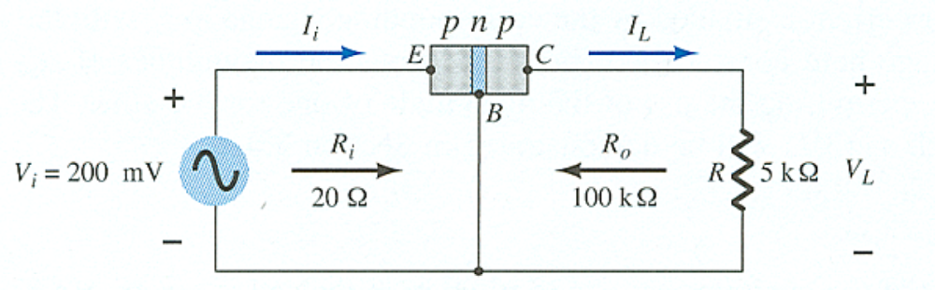
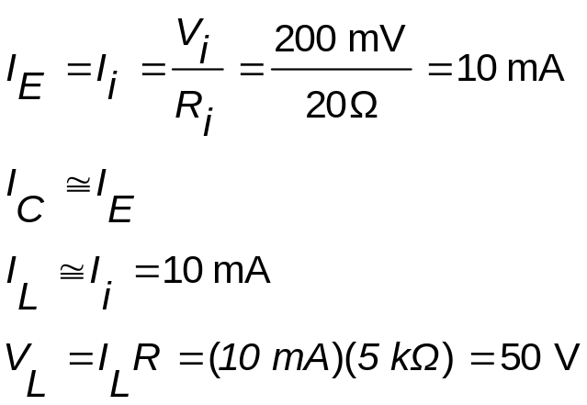
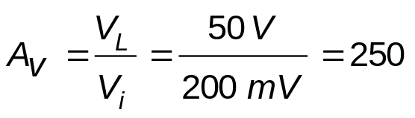
Transistor Amplifier
Currents and Voltages:
Voltage Gain:

Slide 36
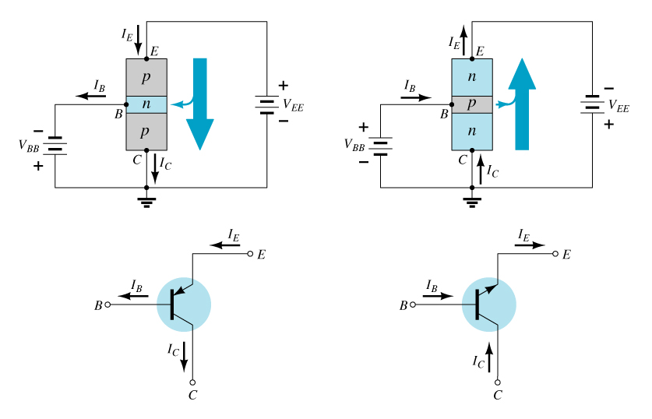
Common-Collector Configuration
The input is on the base and the output is on the emitter.

Slide 37

Common-Collector Configuration
The characteristics are similar to those of the common-emitter amplifier, except the vertical axis is I_{E}.

Slide 38



Power Dissipation
Common-base:
Common-emitter:
Common-collector:

